Slide 1

Product INVEntory & Sales Management System (CRM)
Group 8 Presentation
KodeGo Capstone Project
14-Jan-2022, Friday, PM
Group Members:
Rodrigo Aguirre Jr.
Erika Babuyo
Romnick Dagomboy

Slide 2

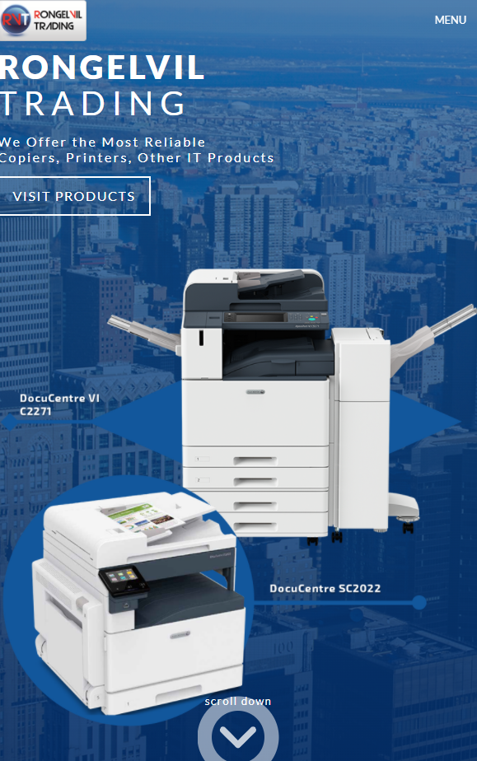
Customer Profile
RONGELVIL TRADING started the business in August of 2009, primarily to engage in the business of selling innovative products specifically for automating office systems and procedures.
Backed by a solid 10 years of hands-on dealings with private companies and government agencies offering superior and most reliable line of products such as Fuji Xerox Digital Copiers and Laser Printers as well as Duplo digital duplicators, the management will continue to provide efficient solutions not only to enterprise but to individual business as well.
RONGELVIL TRADING's mission is to be a valued business organization that provides excellent customer satisfaction

Slide 3
Value Proposition
WEBAPP/PRODUCT
CUSTOMER
Benefits
Simple and Modern
Key Features
Register User and
Log-in to Access
Experience
Sync Across Devices and Responsive
Contains both Static and Dynamic Web Pages
Easy to Use
Access your Data Anywhere/Anytime
Built using HTM, CSS, Bootstrap, PHP, JavaScript & MySQL
Scalable Web Application
Widely utilized Relational Database Functionality
Wants
Fears
Needs
Responsive
Web Pages
Un-attractive
Website
Sync Across Devices
Dashboard that could show Top Performing Products and Month Sales Performance
Unavailable
Information
Include Images
Developer cannot be reached anymore
Mobile Friendly
Would showcase all products carried by the company
Website is using old technology

Slide 4





PROJECT TIMELINE
STAGE 01
Kick-off Meeting
Project Planning
Preparation of Project Tracker
Gather Potential Customer Requirements
Prepare Headers and Relationships for Database
Set-up Database Tables and Columns
Wireframing
STAGE 03
Start of Coding for Static Pages
Set-up Connection of DB.
Create Forms
Create Sitemap
STAGE 02
STAGE 04
STAGE 05
Start Backend Coding and testing
Improve Layout Designs
Initial Testing of All Functionalities
Final Testing and Debugging
Preparation of Project Presentation
Wrapping-up
Project Kick-off Stage
WebApp Design, Coding and Initial Testing
Debugging, Deployment & UAT Stage

Slide 5

OVERALL Project RoadMap
1st Week
Data Gathering, Wireframing
2nd Week
UI/IX
3rd Week
Mock-up/Design
4th Week
Front-end Coding
5th Week
Back-end Coding
6th Week Onwards
QA & Testing |
Hand-over

Slide 6

SITEMAP
LOG-IN PAGE
DASHBOARD PAGE
USER REGISTRATION / ADMIN PAGE
PROFILE INFORMATION
CUSTOMER PAGE
SUPPLIER
PRODUCT / INVENTORY PAGE
SALES PAGE

Slide 7

[ Login]
[ dashboard]
DESCRIPTION | KEY FEATURES
Log-in for registered user only.
User can contact admin directly using the provided link.

Slide 8
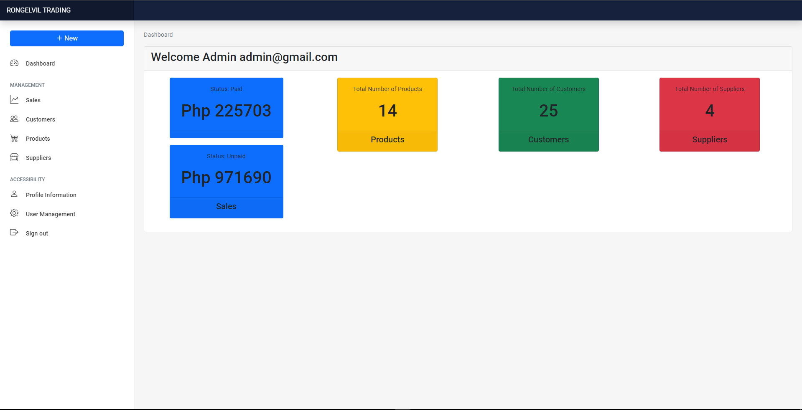
[ Login]
[ dashboard]
DESCRIPTION | KEY FEATURES
This dashboard provides snapshot of the organization resources and real-time performance.
Dashboard can be customized to show weekly, monthly or yearly performance.
Key Metrics can also be included in the dashboard.

Slide 9
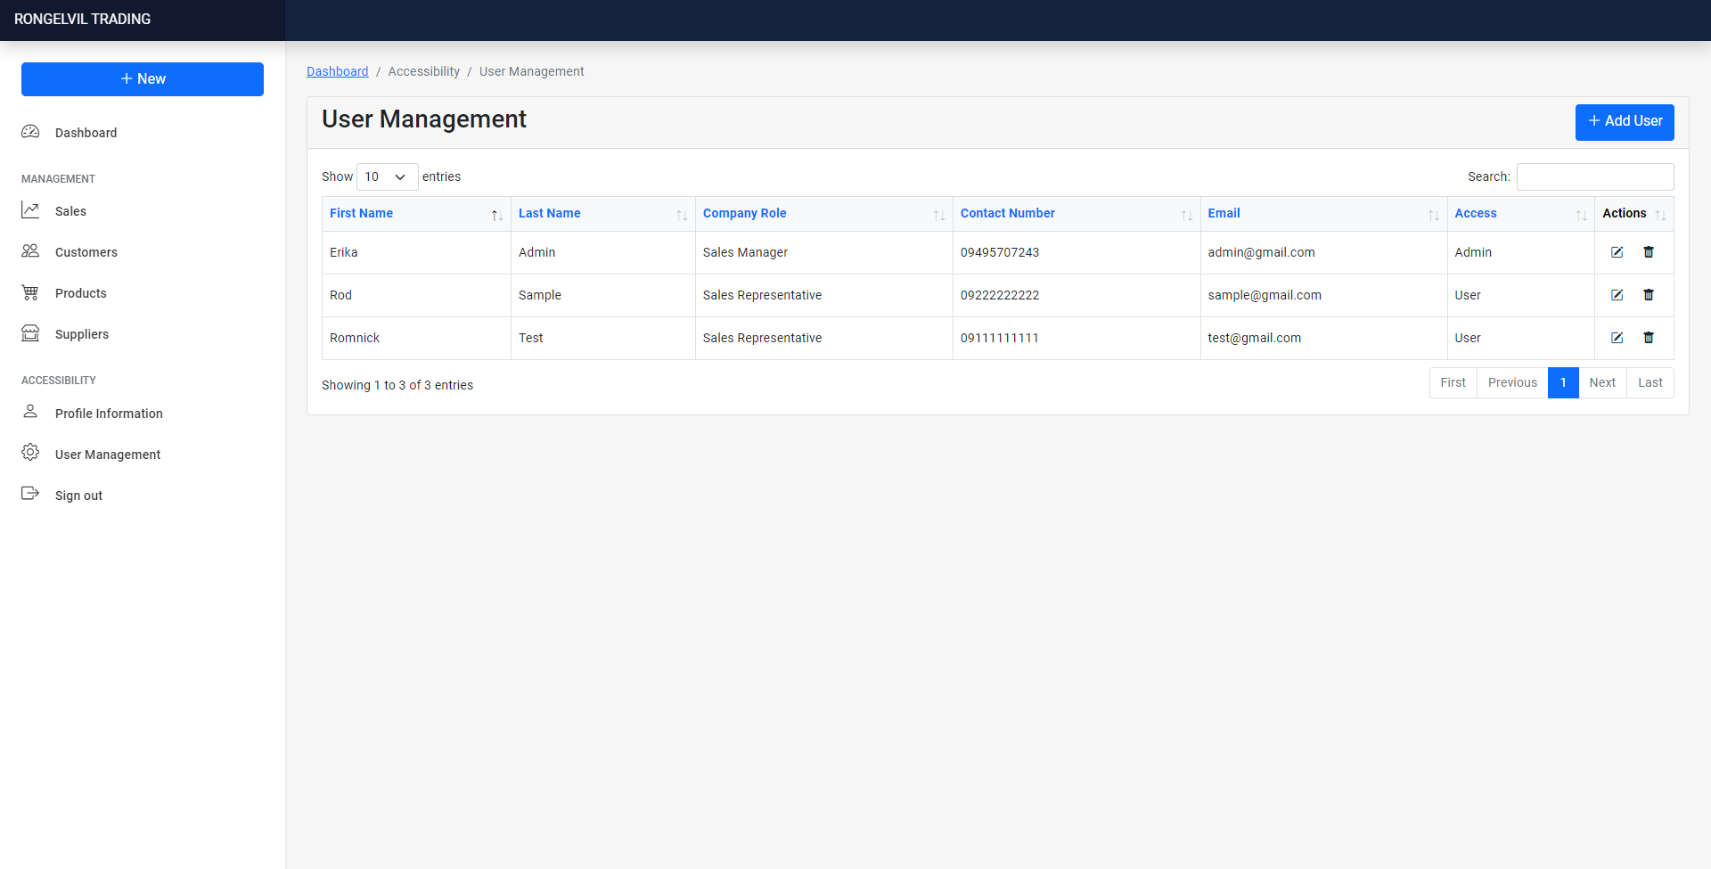
[ User Regis ]
[ Admin]
[ profile]
DESCRIPTION | KEY FEATURES
User Management allows you to Add, Edit and Delete User.
Included breadcrumb for navigation.

Slide 10
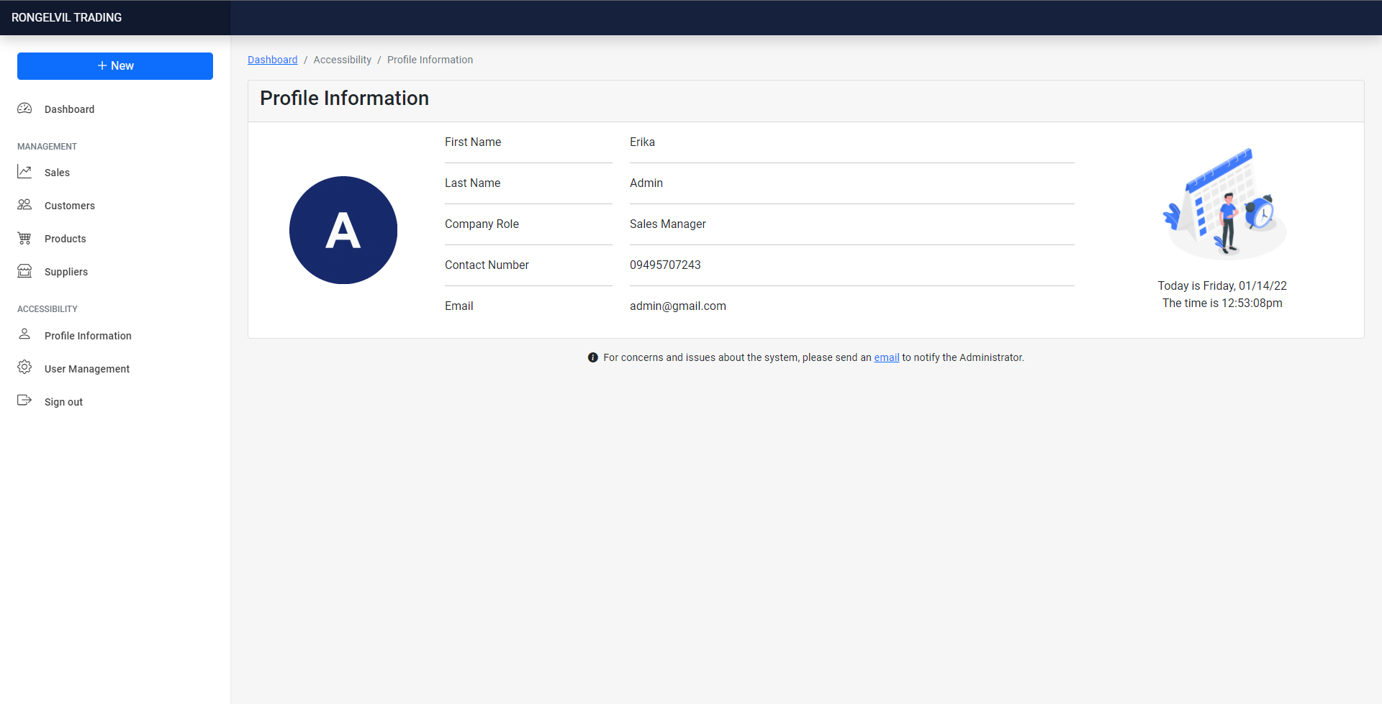
[ User Regis ]
[ Admin]
[ profile]
DESCRIPTION | KEY FEATURES
Profile information will show the complete information for each user, including its assigned role.
Included breadcrumb for navigation.

Slide 11
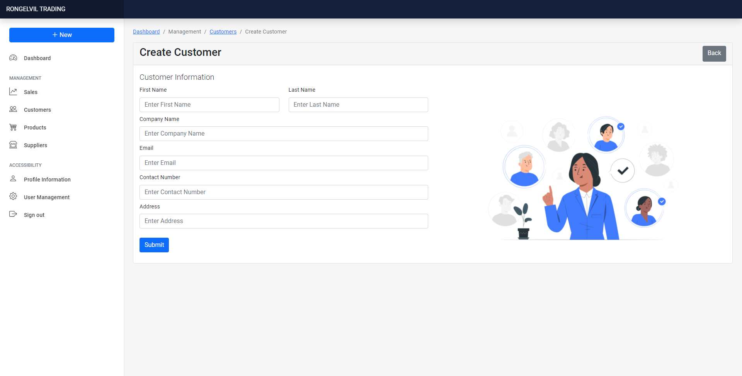
[ customer]
[ supplier]
DESCRIPTION | KEY FEATURES
You can add customer information in this page.
Included breadcrumb for navigation.

Slide 12
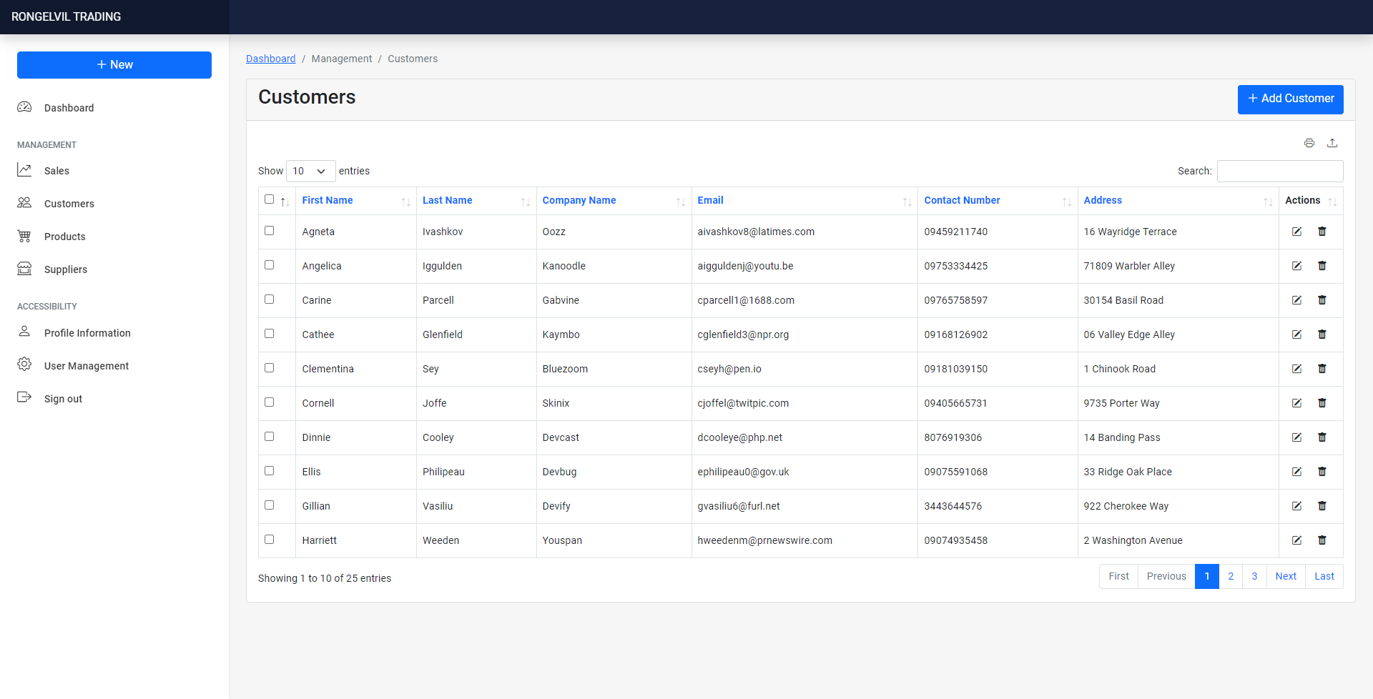
[ customer]
[ supplier]
DESCRIPTION | KEY FEATURES
Customer Page allows you to view All Customers and Add/Edit/Delete customer.
Additional Feature is Downloading of Customer’s List and Printing function.
Included breadcrumb for navigation.

Slide 13
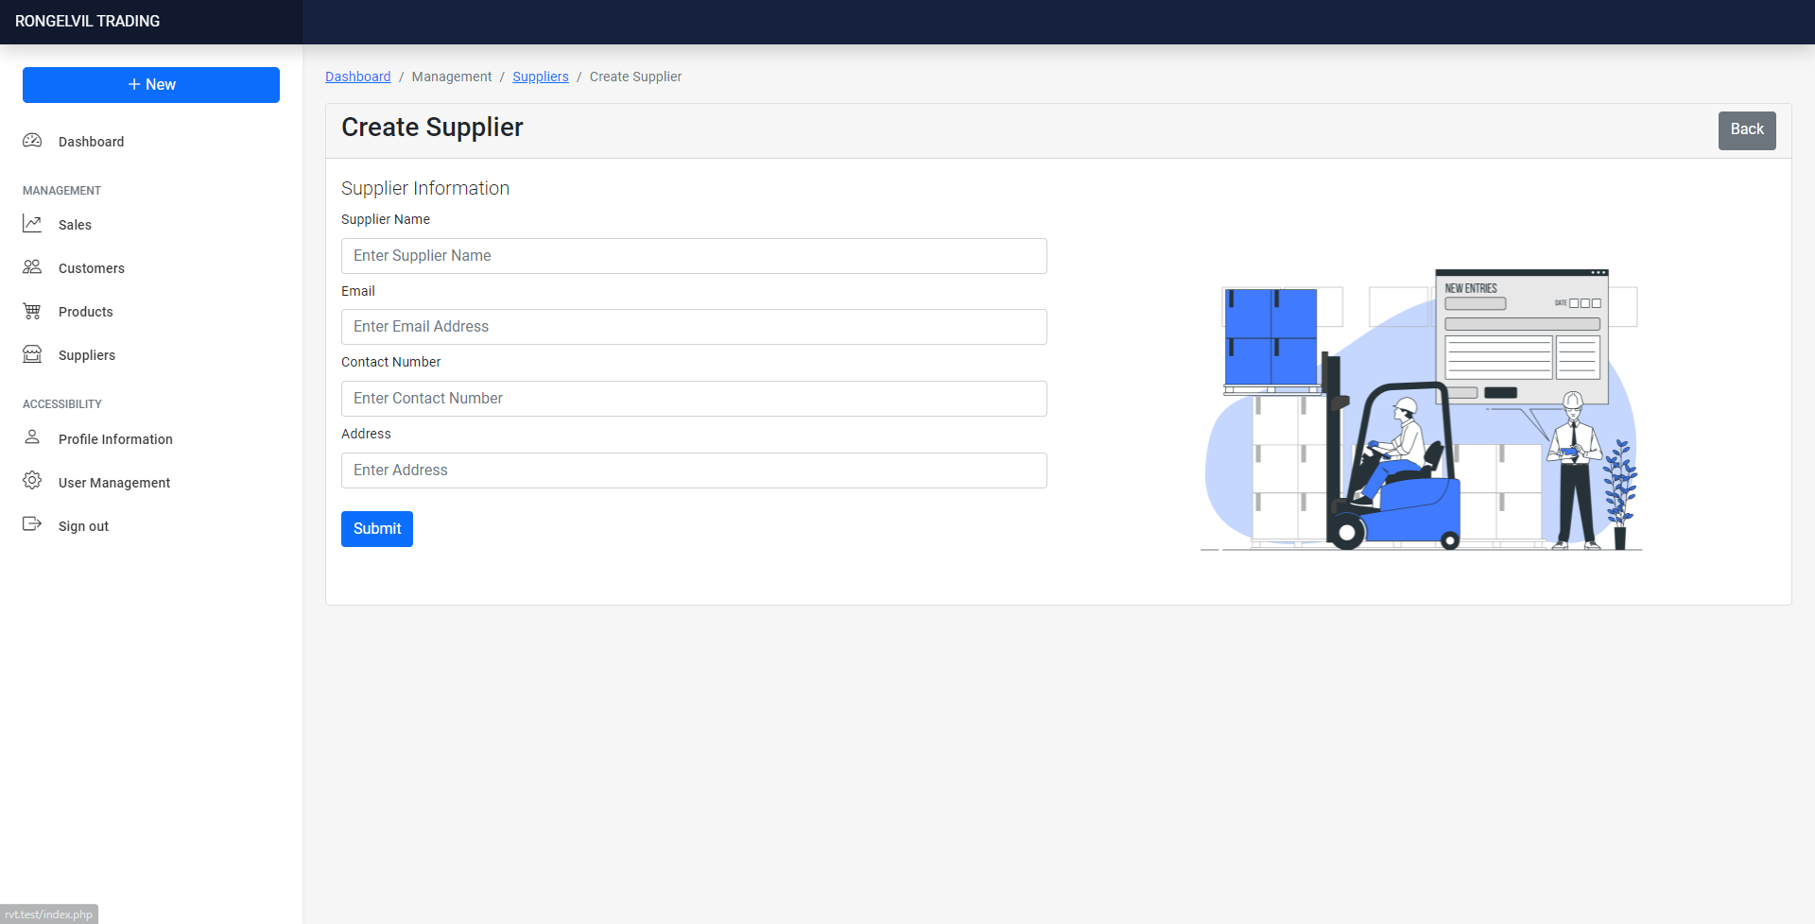
[ customer]
[ supplier]
DESCRIPTION | KEY FEATURES
Create Supplier allows you to add new suppliers.
Included breadcrumb for navigation.

Slide 14
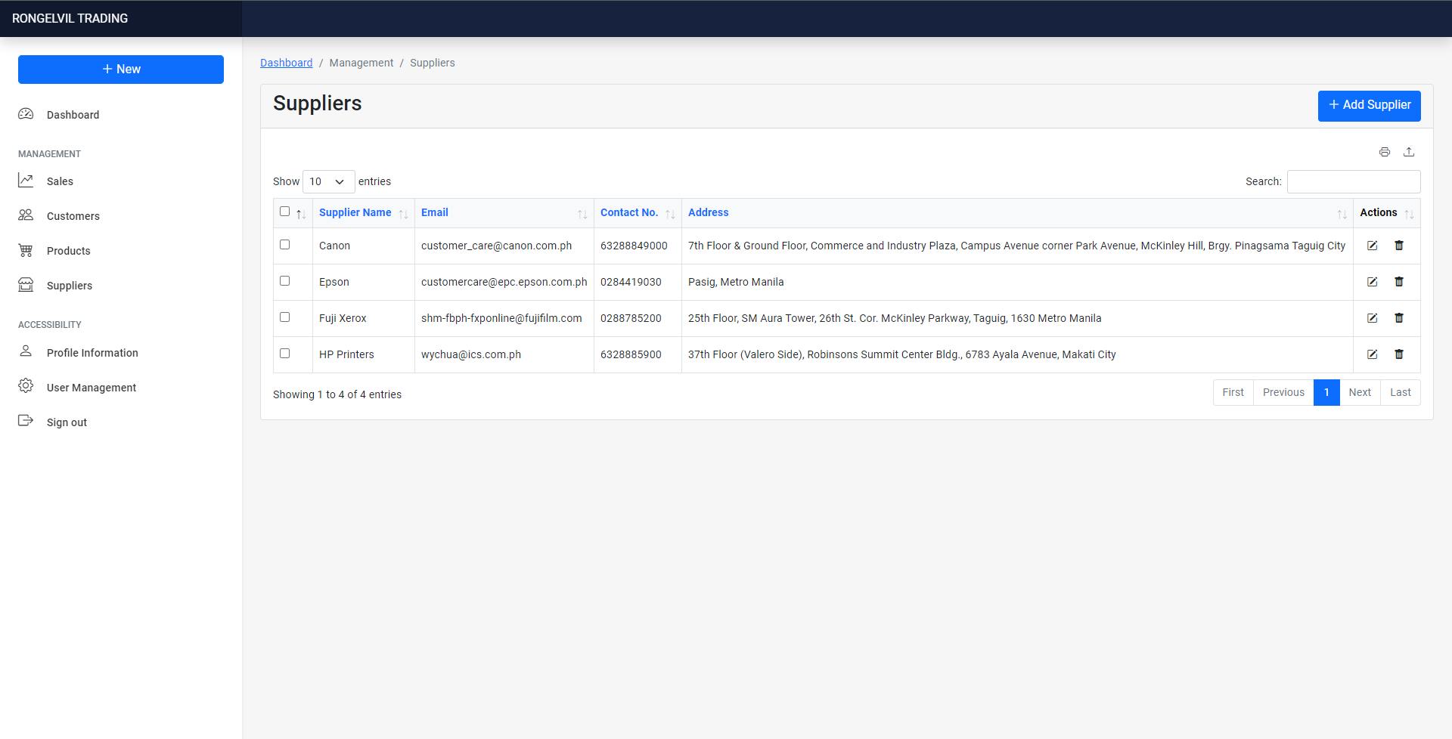
[ customer]
[ supplier]
DESCRIPTION | KEY FEATURES
Supplier Page allows you to Add, Edit and Delete User.
Allows to Print and Download Suppliers List.
Included breadcrumb for navigation.

Slide 15
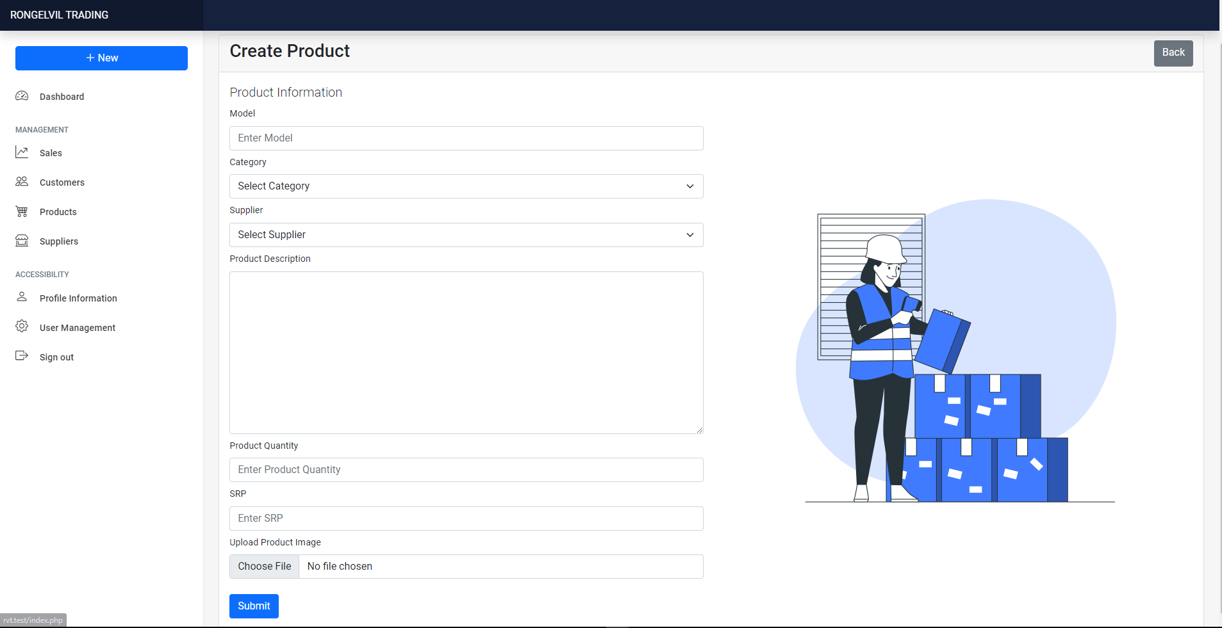
[ product]
[ inventory]
DESCRIPTION | KEY FEATURES
Create Product is used to add new products.
Allows you to upload product photo for ease of reference.

Slide 16
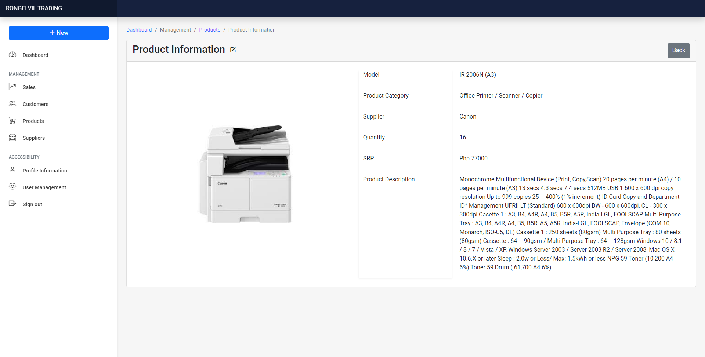
[ product]
[ inventory]
DESCRIPTION | KEY FEATURES
Upon creation of new product, you can see the details in this page.
Attached photo helps to easily identify products based on the inventory or stock.
Included breadcrumb for navigation.

Slide 17
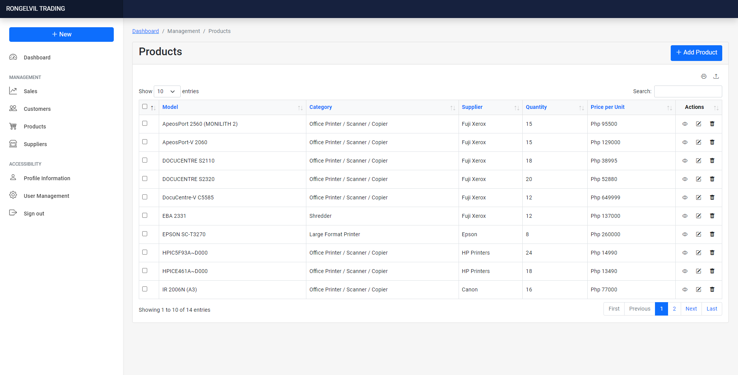
[ product]
[ inventory]
DESCRIPTION | KEY FEATURES
Product Page allows you to Add, Edit and Delete User.
Allows to Print and Download Products List in Excel File Format.
Included breadcrumb for navigation.

Slide 18
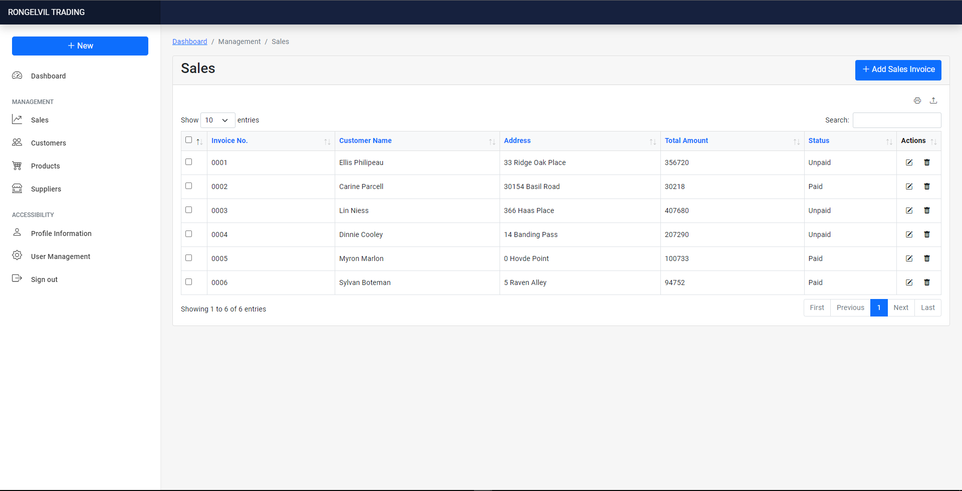
[ sales]
[ invoice]
DESCRIPTION | KEY FEATURES
Sales page allows you to Add, Edit and Delete individual generated sales.
Included breadcrumb for navigation.
Allows you to print and download sales summary in excel format.

Slide 19
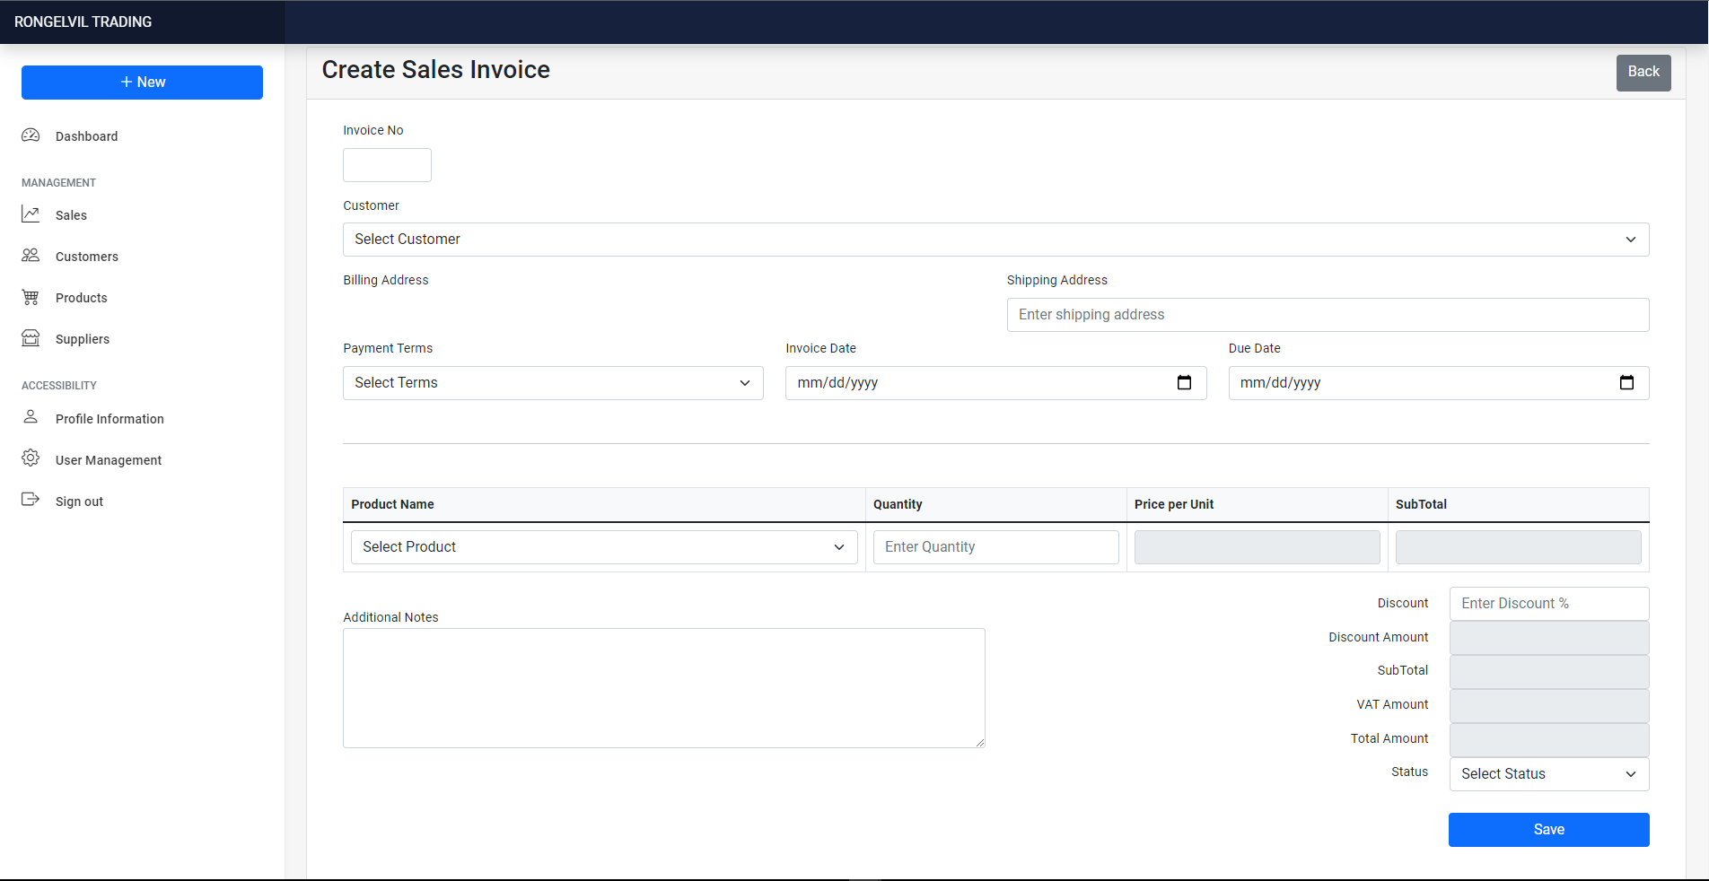
[ sales]
[ invoice]
DESCRIPTION | KEY FEATURES
This page allows you to create and print invoice.
Create Sales Invoice Page may allow saving of invoice, including printing.

Slide 20
[ FEATURES ] FUTURE PLANS
Include e-mail
Integrate WebApp with Landing Page
Add other CRM Modules
Security Implementation/Hardening
May implement VPN connection to avoid security flaws.

Slide 21

Webapp demonstration Proper

Slide 22
Thank you
Rodrigo aguirre jr.
+63 939 9187800 | raguirrejunior@gmail.com
Erika Babuyo
+63 949 570 7243 | erikababuyo@Gmail.com
Romnick Dagomboy
+63 919 704 2092 | nickdagomboy.78@gmail.com

